Slide 1

Smart Contract Security Tips
ConsenSys Primary Colors
ConsenSys Primary Color Shares
SV Ethereum Meetup July 31 2016 - Joseph Chow

Slide 2
June 12 2016
One line of code spurred a series of momentous events in blockchain history

Slide 3
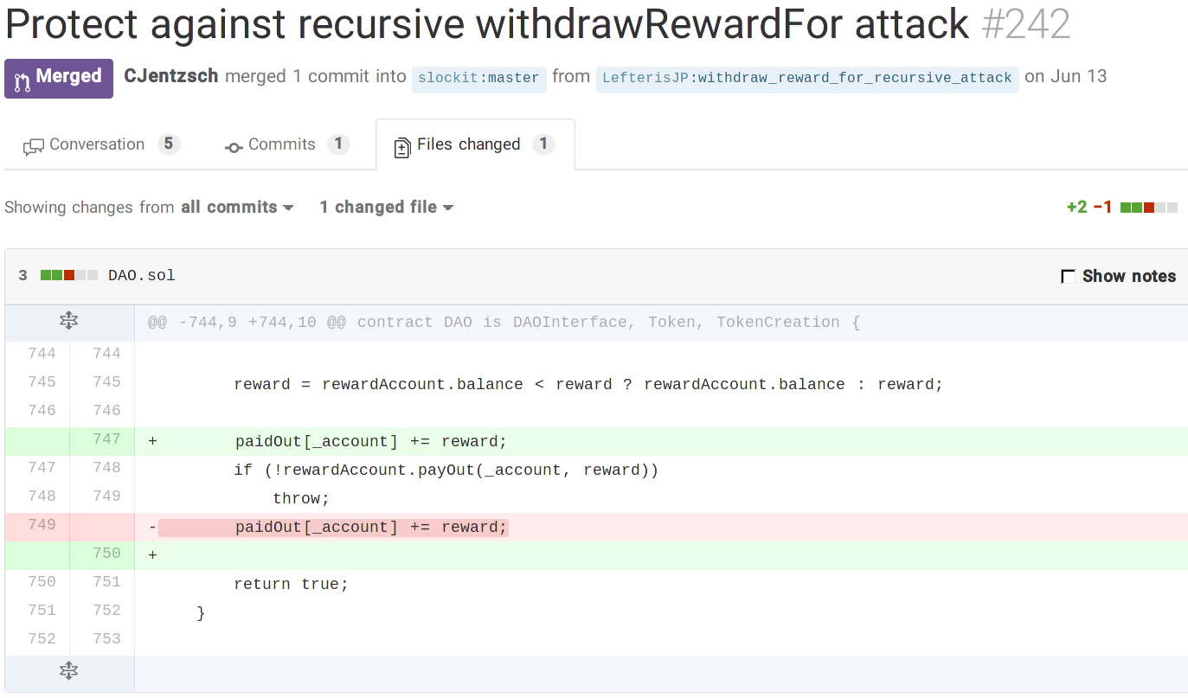

Slide 4



Motivation
ConsenSys has a few crowdfunds coming up: SingularDTV, Gnosis.pm, WeiFund, Poker…
Started writing https://github.com/ConsenSys/smart-contract-best-practices with colleagues
Talk in 1 month on “Security Learnings from BTC Relay”

Slide 5
General Philosophy
Prepare for failure
This is not defeat, but admitting unknown unknowns
Roll out carefully
A production system needs baking time in production
Testnets, beta on mainnet, then production mainnet
Keep contracts simple
Stay up to date
Bibliography at https://github.com/ConsenSys/smart-contract-best-practices and https://github.com/ethereum/wiki/wiki/Safety
Includes community bloggers, Twitter, Reddit...
Be aware of blockchain properties

Slide 6
External Calls
Avoid calls to untrusted contracts as much as you can
Untrusted basically means a contract you’ve not written
Assume untrusted contracts are malicious
Avoid untrustedContract.doSomething()
Avoid address.call()
Avoid address.delegatecall(), address.callcode()
After any untrusted call, assume that the state of your contract has been manipulated

Slide 7
External Calls - Example
contract Victim {
// state
int x = 2;
uint private y = 1;
function foo() { x--;
msg.sender.call.value(10)(); // x, y is now unknown
}
function m() { foo(); // x, y ??
}
function g() { x++; }
function h() internal { y++; }
function bar() {
if (x%2 == 0) h();
}
}
“recursive” reentrancy
contract Untrusted {
function() { // fallback function
v = Victim(msg.sender);
v.foo();
v.g();
v.bar();
}
}
reentrancy

Slide 8
Use send(), avoid call.value()()
// good
if(!someAddress.send(100)) { ... // Some failure code }
// bad
if(!someAddress.call.value(100)()) { ... // Some failure code }
send() is safe because attacker only gets 2,300 gas: only enough to log an event
call.value()() passes along virtually all gas to the attacker’s fallback function

Slide 9
Handle errors in raw calls
Raw calls do not progagate exceptions
address.send(), address.call(), (delegatecall and callcode) return false if they fail
Unlike ExternalContract(address).doSomething() which will throw if doSomething() throws
// good
if(!someAddress.send(100)) { ... // Some failure code }
// bad
someAddress.send(100); // an “unchecked send”

Slide 10
Control flow after external calls
Assume any untrusted contract will call malicious code
// INSECURE
mapping (address => uint) private userBalances;
function withdrawBalance() public {
uint amountToWithdraw = userBalances[msg.sender];
if (!(msg.sender.call.value(amountToWithdraw)())) { // attacker can call withdrawBalance again here
throw;
}
userBalances[msg.sender] = 0;
}

Slide 11
Keep fallback functions simple
Receiving Ether from a .send(), fallback function only gets 2,300 gas: can only log an event
function() { LogDepositReceived(msg.sender); }
Use a proper function if more gas is required
function deposit() external { balances[msg.sender] += msg.value; }
// bad, uses more than 2,300 gas. Breaks senders that use send() instead of call.value()()
function() { balances[msg.sender] += msg.value; }

Slide 12
Call Depth Attack
Any call (even a fully trusted and correct one) can be made to fail
The EVM “CALL (and CREATE) stack” has a maximum depth of 1024
Attacker can make recursive calls to depth 1023, then call your function and all of its subcalls will fail
// INSECURE mapping(address => uint) refunds; function withdrawRefund(address recipient) { uint refund = refunds[recipient]; refunds[recipient] = 0; recipient.send(refund); // this line is vulnerable to a call depth attack. Solution “if !send throw”. }
In Solidity, “internal” functions are implemented as JUMP, instead of CALL, so depth does not increase
Contract creation will throw when https://github.com/ethereum/solidity/pull/710 merged
A solution is for msg.sender to “pull” their refund instead of a contract “push” to the recipient

Slide 13
Denial of Service
Unexpected throw; the block gas limit; unbounded arrays; misunderstanding gas refunds.
// INSECURE contract Auction { address currentLeader; uint highestBid; function bid() { if (msg.value <= highestBid) { throw; } if (!currentLeader.send(highestBid)) { throw; } // Refund the old leader, and throw if it fails currentLeader = msg.sender; highestBid = msg.value; } }
A currentLeader that refuses payment will permanently be the leader.
Throw can’t be removed otherwise Call Depth Attack. Solution: favor “pull” over “push”

Slide 14
Favor “pull” over “push” for external calls
// good contract auction { address highestBidder; uint highestBid; mapping(address => uint) refunds; function bid() external { if (msg.value < highestBid) throw; if (highestBidder != 0) { refunds[highestBidder] += highestBid; // record the refund that this user can claim } highestBidder = msg.sender; highestBid = msg.value; }
function withdrawRefund() external { uint refund = refunds[msg.sender]; refunds[msg.sender] = 0; if (!msg.sender.send(refund)) { refunds[msg.sender] = refund; // reverting state because send failed } } }

Slide 15
More information
https://github.com/ConsenSys/smart-contract-best-practices
https://github.com/ethereum/wiki/wiki/Safety
Feel free to edit the wiki or submit a pull request
Fix a typo, or example
Add a link to a community blog post (even your own), or other related security info
Write a new section
Reentrancy and Race Conditions
Timestamp Dependence
Transaction-Ordering Dependence
And others

Slide 16
Conclusion
Prepare for failure
Roll out carefully
Keep contracts simple
Calling untrusted code is always dangerous
https://github.com/ConsenSys/smart-contract-best-practices
https://github.com/ethereum/wiki/wiki/Safety

Slide 17
License: Apache 2.0
http://www.apache.org/licenses/LICENSE-2.0

Slide 18
Appendix: TheDAO heist
function splitDAO(... ... withdrawRewardFor(msg.sender); // be nice, and get his rewards totalSupply -= balances[msg.sender]; balances[msg.sender] = 0; paidOut[msg.sender] = 0; return true; }
Above snippet from a presentation given by Christoph Jentzsch

Slide 19
June 12 2016
Around 12 hours ago user Eththrowa on the DAOHub Forum spotted that while we had identified the vulnerability in one aspect of the DAO Framework, the existing (and deployed) DAO reward account mechanism was affected. His message and our prompt confirmation can be found here. We issued a fix immediately as part of the DAO Framework 1.1 milestone.
https://blog.slock.it/no-dao-funds-at-risk-following-the-ethereum-smart-contract-recursive-call-bug-discovery-29f482d348b

